Slide 1
Machine-Level Programming
60080013: Computer Organization
3rd Lecture
Instructors:
Sun Heng

Slide 2
Intel x86 Evolution: Milestones
Name Date Transistors
8086 1978 29K
  First 16-bit processor
  Basis for IBM PC & DOS
386 1985 275K
  First 32 bit processor , referred to as IA32
  Added “flat addressing”
  Capable of running Unix
Pentium 4E 2004 125M
  First 64-bit processor, referred to as x86-64
Core i7 2008 781M
  Multi-core machines
Core i7-12th(7nm) 2022 21.7B
  Servers or mobile machines

Slide 3
x86 Clones: Advanced Micro Devices (AMD)
  Over the years, several companies have produced processors that are compatible with Intel processors, capable of running the exact same machine-level programs. Chief among these is Advanced Micro Devices (AMD).
    AMD has followed just behind Intel
    A little bit slower, a lot cheaper

Slide 4
Machine Code Definitions
computer systems employ several different forms of abstraction, hiding details of an implementation through the use of a simpler abstract model. Two of these are especially important for machine-level programming.
  Architecture (also ISA: instruction set architecture): the format and behavior of a machine-level program is defined by the ISA
    The parts of a processor design that one needs to understand to write assembly code.
    Example ISAs (Intel): IA32, x86-64
  Memory model: a very large byte array

Slide 5
Assembly Programmer’s View
The compiler does most of the work in the overall compilation sequence, transforming programs expressed in the relatively abstract execution model provided by C into the very elementary instructions that the processor executes. The assembly-code representation is very close to machine code.

Slide 6
Assembly Programmer’s View
CPU
Memory
Registers
Addresses
Data
Code
Data
Stack
PC
Condition
Codes
Instructions
Programmer-Visible State
  PC: Programcounter
    Address of next instruction
  Register file
    Heavily used program data
  Condition codes
    Store status information about most recent arithmetic operation
    Used for conditional branching
  Memory
    Byte addressable array
    Code and user data
    Stack to support procedures

Slide 7
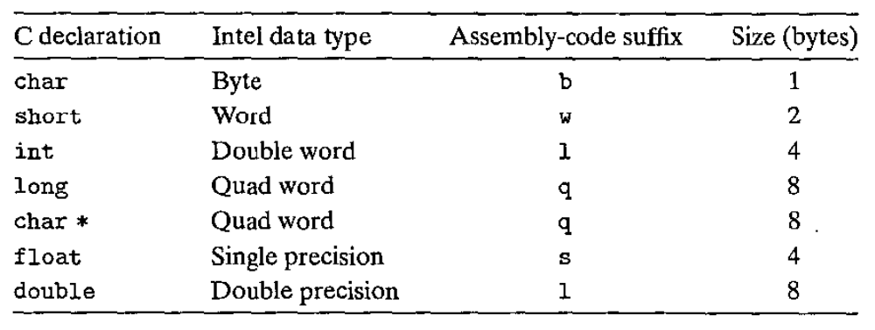
Assembly Characteristics: Data Types
Intel uses the term “word” to refer to a 16-bit data type. Based on this, they refer to 32-bit quantities as “double words.” They refer to 64-bit quantities as “quad words.”

Slide 8
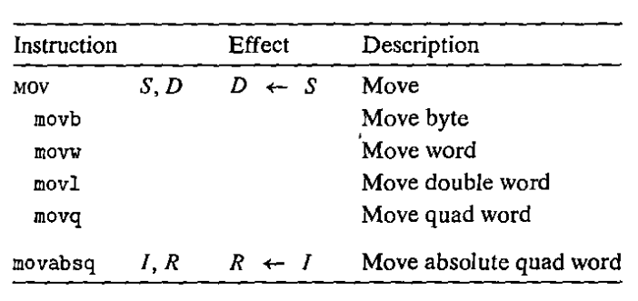
Assembly Characteristics: Instructions
The most heavily used instructions include data movement instructions-MOV class.
The class consists of four instructions: movb, movw, movl, and movq. All four of these instructions have similar effects; they differ primarily in that they operate on data of different sizes: 1, 2, 4, and 8 bytes, respectively.

Slide 9
x86-64 Integer Registers
  An x86-64 central processing unit (CPU) contains a set of 16 general-purpose registers storing 64-bit values. These registers are used to store integer data as well as pointers.

Slide 10
x86-64 Integer Registers
%rax
%r8
%eax
accumulate
%r8d
%rbx
%r9
%ebx
base
%r9d
%rcx
%r10
%ecx
counter
%r10d
general purpose
%rdx
%r11
%edx
data
%r11d
%rsi
%r12
%esi
source
index
%r12d
%rdi
destination
index
%r13
%edi
%r13d
%rsp
stack
pointer
%r14
%esp
%r14d
%rbp
base
pointer
%r15
%ebp
%r15d
  Can reference low-order 4 bytes

Slide 11
Moving Data
%rax
%rcx
Moving Data
  movq Source, Dest
Operand Types
  Immediate: Constant integer data
    Example: $0x400, $-533
    Like C constant, but prefixed with ‘$’
    Encoded with 1, 2, 4 or 8 bytes
  Register: One of 16 integer registers
    Example: %rax, %r13
    But %rsp reserved for special use
    Others have special uses for particular instructions
  Memory: 8 consecutive bytes of memory at address given by register
    Simplest example: (%rax)
    Various other “addressing modes”
%rdx
%rbx
%rsi
%rdi
%rsp
%rbp
%rN
Warning: Intel docs use
mov Dest, Source

Slide 12
Simple Memory Addressing Modes
Normal (R) Mem[Reg[R]]
  Register R specifies memory address
  Aha! Pointer dereferencing in C
  movq (%rcx),%rax
Displacement D(R) Mem[Reg[R]+D]
  Register R specifies start of memory region
  Constant displacement D specifies offset
  movq 8(%rbp),%rdx

Slide 13
Complete Memory Addressing Modes
Most General Form
D(Rb,Ri,S) Mem[Reg[Rb]+S*Reg[Ri]+ D]
  D: Constant “displacement”
  Rb: Base register: Any of 16 integer registers
  Ri: Index register: Any, except for %rsp
  S: Scale: 1, 2, 4, or 8
Special Cases
(Rb,Ri) Mem[Reg[Rb]+Reg[Ri]]
D(Rb,Ri) Mem[Reg[Rb]+Reg[Ri]+D]
(Rb,Ri,S) Mem[Reg[Rb]+S*Reg[Ri]]

Slide 14
Address Computation Examples
Carnegie Mellon
%rdx | 0xf000
%rcx | 0x0100
Expression | Address Computation | Address
0x8(%rdx)
(%rdx,%rcx)
(%rdx,%rcx,4)
0x80(,%rdx,2)
Expression | Address Computation | Address
0x8(%rdx) | 0xf000 + 0x8 | 0xf008
(%rdx,%rcx) | 0xf000 + 0x100 | 0xf100
(%rdx,%rcx,4) | 0xf000 + 4*0x100 | 0xf400
0x80(,%rdx,2) | 2*0xf000 + 0x80 | 0x1e080

Slide 15
movq Operand Combinations
Source
Dest
Src,Dest
C Analog
Reg
movq $0x4,%rax
temp = 0x4;
Imm
Mem
movq $-147,(%rax)
*p = -147;
Reg
movq %rax,%rdx
temp2 = temp1;
movq
Reg
Mem
movq %rax,(%rdx)
*p = temp;
Mem
Reg
movq (%rax),%rdx
temp = *p;
Cannot do memory-memory transfer with a single instruction

Slide 16
Example of Simple Addressing Modes
void swap
(long *xp, long *yp)
{
long t0 = *xp;
long t1 = *yp;
*xp = t1;
*yp = t0;
}
swap:
movq (%rdi), %rax
movq (%rsi), %rdx
movq %rdx, (%rdi)
movq %rax, (%rsi)
ret

Slide 17
Understanding Swap()
Memory
void swap
(long *xp, long *yp)
{
long t0 = *xp;
long t1 = *yp;
*xp = t1;
*yp = t0;
}
Registers
%rdi
%rsi
%rax
%rdx
Register Value
%rdi xp
%rsi yp
%rax t0
%rdx t1
swap:
movq (%rdi), %rax # t0 = *xp
movq (%rsi), %rdx # t1 = *yp
movq %rdx, (%rdi) # *xp = t1
movq %rax, (%rsi) # *yp = t0
ret

Slide 18
Understanding Swap()
Memory
Registers
Address
123
0x120
%rdi
0x120
0x118
%rsi
0x100
0x110
%rax
0x108
%rdx
456
0x100
swap:
movq (%rdi), %rax # t0 = *xp
movq (%rsi), %rdx # t1 = *yp
movq %rdx, (%rdi) # *xp = t1
movq %rax, (%rsi) # *yp = t0
ret

Slide 19
Understanding Swap()
Memory
Registers
Address
123
0x120
%rdi
0x120
0x118
%rsi
0x100
0x110
%rax
123
0x108
%rdx
456
0x100
swap:
movq (%rdi), %rax # t0 = *xp
movq (%rsi), %rdx # t1 = *yp
movq %rdx, (%rdi) # *xp = t1
movq %rax, (%rsi) # *yp = t0
ret

Slide 20
Understanding Swap()
Memory
Registers
Address
123
0x120
%rdi
0x120
0x118
%rsi
0x100
0x110
%rax
123
0x108
%rdx
456
456
0x100
swap:
movq (%rdi), %rax # t0 = *xp
movq (%rsi), %rdx # t1 = *yp
movq %rdx, (%rdi) # *xp = t1
movq %rax, (%rsi) # *yp = t0
ret

Slide 21
Understanding Swap()
Memory
Registers
Address
456
0x120
%rdi
0x120
0x118
%rsi
0x100
0x110
%rax
123
0x108
%rdx
456
456
0x100
swap:
movq (%rdi), %rax # t0 = *xp
movq (%rsi), %rdx # t1 = *yp
movq %rdx, (%rdi) # *xp = t1
movq %rax, (%rsi) # *yp = t0
ret

Slide 22
Understanding Swap()
Memory
Registers
Address
456
0x120
%rdi
0x120
0x118
%rsi
0x100
0x110
%rax
123
0x108
%rdx
456
123
0x100
swap:
movq (%rdi), %rax # t0 = *xp
movq (%rsi), %rdx # t1 = *yp
movq %rdx, (%rdi) # *xp = t1
movq %rax, (%rsi) # *yp = t0
ret

Slide 23
Some Arithmetic Operations
Carnegie Mellon
Two Operand Instructions:
  Format Computation
    addq Src,Dest Dest = Dest + Src
    subq Src,Dest Dest = Dest − Src
    imulq Src,Dest Dest = Dest * Src
    salq Src,Dest Dest = Dest << Src Also called shlq
    sarq Src,Dest Dest = Dest >> Src Arithmetic
    shrq Src,Dest Dest = Dest >> Src Logical
    xorq Src,Dest Dest = Dest ^ Src
    andq Src,Dest Dest = Dest & Src
    orq Src,Dest Dest = Dest | Src
Watch out for argument order!

Slide 24
Some Arithmetic Operations
Carnegie Mellon
One Operand Instructions
    incq Dest Dest = Dest + 1
    decq Dest Dest = Dest − 1
    negq Dest Dest = − Dest
    notq Dest Dest = ~Dest
See book for more instructions

Slide 25
Processor State (x86-64, Partial)
So far, we have only considered the behavior of straight-line code, where instructions follow one another in sequence. Some constructs in C, such as conditionals, loops, and switches, require conditional execution, where the sequence of operations that get performed depends on the outcomes of tests applied to the data. Machine code provides two basic low-level mechanisms for implementing conditional behavior: it tests data values and then alters either the control flow or the data flow based on the results of these tests.
In addition to the integer registers, the CPU maintains a set of single-bit condition code registers describing attributes of the most recent arithmetic or logical operation. These registers can then be tested to perform conditional branches.

Slide 26
Processor State (x86-64, Partial)
Information about currently executing program
  Temporary data
  ( %rax, … )
  Location of runtime stack
  ( %rsp )
  Status of recent tests
  ( CF, ZF, SF, OF )
Registers
%rax
%r8
%rbx
%r9
%rcx
%r10
%rdx
%r11
Current stack top
%rsi
%r12
%rdi
%r13
%rsp
%r14
%rbp
%r15
CF
ZF
SF
OF
Condition codes

Slide 27
Condition Codes (Implicit Setting)
Single bit registers
  CF Carry Flag (for unsigned) SF Sign Flag (for signed)
  ZF Zero Flag OF Overflow Flag (for signed)
Implicitly set (as side effect) by arithmetic operations
  Example: addq Src,Dest ↔ t = a+b
  CF set if carry/borrow out from most significant bit (unsigned overflow)
  ZF set if t == 0
  SF set if t < 0 (as signed)
  OF set if two’s-complement (signed) overflow
  (a>0 && b>0 && t<0) || (a<0 && b<0 && t>=0)
Not set by leaq instruction

Slide 28
Condition Codes (Explicit Setting: Compare)
Explicit Setting by Compare Instruction
  cmpq Src2, Src1
  cmpq b,a like computing a-b without setting destination
  CF set if carry/borrow out from most significant bit
  (used for unsigned comparisons)
  ZF set if a == b
  SF set if (a-b) < 0 (as signed)
  OF set if two’s-complement (signed) overflow
  (a>0 && b<0 && (a-b)<0) || (a<0 && b>0 && (a-b)>0)

Slide 29
Condition Codes (Explicit Setting: Test)
Explicit Setting by Test instruction
  testq Src2, Src1
    testq b,a like computing a&b without setting destination
  Sets condition codes based on value of Src1 & Src2
  ZF set when a&b == 0
  SF set when a&b < 0
Very often:
testq %rax,%rax

Slide 30
Reading Condition Codes
SetX Instructions
  Set low-order byte of destination to 0 or 1 based on combinations of condition codes
  Does not alter remaining 7 bytes
SetX | Condition | Description
sete | ZF | Equal / Zero
setne | ~ZF | Not Equal / Not Zero
sets | SF | Negative
setns | ~SF | Nonnegative
setg | ~(SF^OF)&~ZF | Greater (Signed)
setge | ~(SF^OF) | Greater or Equal (Signed)
setl | (SF^OF) | Less (Signed)
setle | (SF^OF)|ZF | Less or Equal (Signed)
seta | ~CF&~ZF | Above (unsigned)
setb | CF | Below (unsigned)

Slide 31
x86-64 Integer Registers
%rax
%r8
%al
%r8b
%rbx
%r9
%bl
%r9b
%rcx
%r10
%cl
%r10b
%rdx
%r11
%dl
%r11b
%rsi
%r12
%sil
%r12b
%rdi
%r13
%dil
%r13b
%rsp
%r14
%spl
%r14b
%rbp
%r15
%bpl
%r15b
  Can reference low-order byte

Slide 32
Reading Condition Codes (Cont.)
SetX Instructions:
  Set single byte based on combination of condition codes
One of addressable byte registers
  Does not alter remaining bytes
  Typically use movzbl to finish job
    movzbl instruction also set upper bits to 0
Register | Use(s)
%rdi | Argument x
%rsi | Argument y
%rax | Return value
int gt (long x, long y)
{
return x > y;
}
cmpq %rsi, %rdi # Compare x:y
  setg %al # Set when >
  movzbl %al, %eax # Zero rest of %rax
ret

Slide 33
Reading Condition Codes (Cont.)
SetX Instructions:
  Set single byte based on combination of condition codes
One of addressable byte registers
  Does not alter remaining bytes
  Typically use movzbl to finish job
    32-bit instructions also set upper 32 bits to 0
Beware weirdness movzbl (and others)
movzbl %al, %eax
0x00000000
%rax
%rax
%al
0x000000
%al
0x000000
%al
%eax
Register | Use(s)
%rdi | Argument x
%rsi | Argument y
%rax | Return value
int gt (long x, long y)
{
return x > y;
}
Zapped to all 0’s
cmpq %rsi, %rdi # Compare x:y
  setg %al # Set when >
  movzbl %al, %eax # Zero rest of %rax
ret

Slide 34

Jumping
Carnegie Mellon
  assembly code
  The instruction jmp .L1 will cause the program to skip over the movq instruction and instead resume execution with the popq instruction. In generating the object-code file, the assembler determines the addresses of all labeled instructions and encodes the jump targets (the addresses of the destination instructions) as part of the jump instructions.

Slide 35
Jumping
Carnegie Mellon
  indirect jump
    jmp *%rax
    Jmp *(%rax)
  The jmp instruction jumps unconditionally. It can be either a direct jump, where the jump target is encoded as part of the instruction, or an indirect jump, where the jump target is read from a register or a memory location. Direct jumps are written in assembly code by giving a label as the jump target, for example, the label .L1 in the code shown. Indirect jumps are written using ‘*’ followed by an operand specifier.

Slide 36
Jumping
Carnegie Mellon
jX Instructions
  Jump to different part of code depending on condition codes
jX | Condition | Description
jmp | 1 | Unconditional
je | ZF | Equal / Zero
jne | ~ZF | Not Equal / Not Zero
js | SF | Negative
jns | ~SF | Nonnegative
jg | ~(SF^OF)&~ZF | Greater (Signed)
jge | ~(SF^OF) | Greater or Equal (Signed)
jl | (SF^OF) | Less (Signed)
jle | (SF^OF)|ZF | Less or Equal (Signed)
ja | ~CF&~ZF | Above (unsigned)
jb | CF | Below (unsigned)

Slide 37
Conditional Branch Example (Old Style)
Generation
  shark> gcc –Og -S –fno-if-conversion control.c
absdiff:
cmpq %rsi, %rdi # x:y
jle .L4
movq %rdi, %rax
subq %rsi, %rax
ret
.L4: # x <= y
movq %rsi, %rax
subq %rdi, %rax
ret
long absdiff
(long x, long y)
{
long result;
if (x > y)
result = x-y;
else
result = y-x;
return result;
}
Register | Use(s)
%rdi | Argument x
%rsi | Argument y
%rax | Return value

Slide 38
Expressing with Goto Code
C allows goto statement
Jump to position designated by label
long absdiff
(long x, long y)
{
long result;
if (x > y)
result = x-y;
else
result = y-x;
return result;
}
long absdiff_j
(long x, long y)
{
long result;
int ntest = x <= y;
if (ntest) goto Else;
result = x-y;
goto Done;
Else:
result = y-x;
Done:
return result;
}

Slide 39
General “Do-While” Translation
C Code
Goto Version
do
Body
while (Test);
loop:
Body
if (Test)
goto loop
The effect of the loop is to repeatedly execute body-statement, evaluate test-expr, and continue the loop if the evaluation result is nonzero. Observe that body statement is executed at least once.
On each iteration the program evaluates the body statement and then the test expression. If the test succeeds, the program goes back for another iteration.

Slide 40
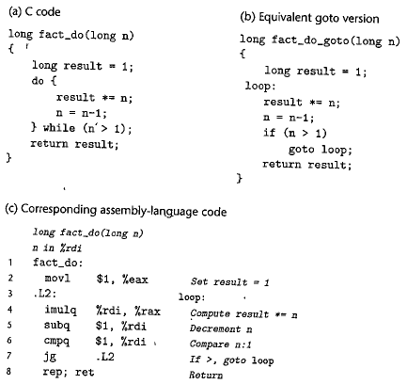
Carnegie Mellon
“Do-While” Loop Example

Slide 41
General “While” Translation
Carnegie Mellon
While version
while (Test)
Body
While differs from do-while in that test-expr is evaluated and the loop is potentially terminated before the first execution of body-statement. There are a number of ways to translate a while loop into machine code. One common approach, also used by gcc, is to transform the code into a do-while loop by using a conditional branch to skip the first execution of the body.
Do-While Version
if (!Test)
goto done;
do
Body
while(Test);
done:

Slide 42
“For” Loop → While Loop
Carnegie Mellon
For Version
for (Init; Test; Update )
Body
The C language standard states that the behavior of such a loop is identical to the code using a while loop.
The program first evaluates the initialization expression init-expr. It enters a loop where it first evaluates the test condition test-expr, exiting if the test fails, then executes the body of the loop body-statement, and finally evaluates the update expression update-expr.
While Version
Init;
while (Test ) {
Body
Update;
}

Slide 43
Procedures
Carnegie Mellon
A procedure call involves passing both data (in the form of procedure parameters and return values) and control from one part of a program to another. In addition, it must allocate space for the local variables of the procedure on entry and deallocate them on exit. Most machines, including X86-64, provide only simple instructions for transferring control to and from procedures. The passing of data and the allocation and deallocation of local variables is handled by manipulating the program stack.

Slide 44
Stack
Carnegie Mellon
X86-64 programs make use of the program stack to support procedure calls. The machine uses the stack to pass procedure arguments, to store return information, to save registers for later restoration, and for local storage.The portion of the stack allocated for a single procedure call is called a stack frame. This Figure diagrams the general structure of a stack frame. The topmost stack frame is delimited by the pointer, with register %rsp serving as the stack pointer. The stack pointer can move while the procedure is executing, and hence most information is accessed relative to the frame pointer.

Slide 45
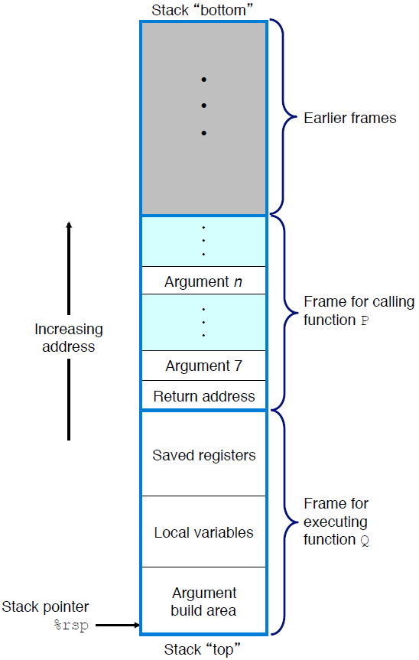
Stack Frame Structure
Carnegie Mellon
Suppose procedure P (the caller) calls procedure Q (the callee). The arguments to Q are contained within the stack frame for P. In addition, when P calls Q, the return address within P where the program should resume execution when it returns from Q is pushed onto the stack, forming the end of P's stack frame.

Slide 46
Stack Frame Structure
Carnegie Mellon
Procedure Q also uses the stack for any local variables that cannot be stored in registers. This can occur for the following reasons:
There are not enough registers to hold all of the local data.
Some of the local variables are arrays or structures and hence must be accessed by array or structure references.
The address operator ‘&’ is applied to a local variable, and hence we must be able to generate an address for it.

Slide 47
Stack Frame Structure
Carnegie Mellon
the stack grows toward lower addresses and the stack pointer %rsp points to the top element of the stack. Data can be stored on and retrieved from the stack using the pushq and popq instructions. Space for data with no specified initial value can be allocated on the stack by simply decrementing the stack pointer by an appropriate amount. Similarly, space can be deallocated by incrementing the stack pointer.

Slide 48

Transferring Control
Carnegie Mellon
The call instruction has a target indicating the address of the instruction where the called procedure starts. Like jumps, a call can either be direct or indirect. In assembly code, the target of a direct call is given as a label, while the target of an indirect call is given by a * followed by an operand specifier.
The effect of a call instruction is to push a return address on the stack and jump to the start of the called procedure. The return address is the address of the instruction immediately following the call in the program, so that execution will resume at this location when the called procedure returns.
The ret instruction pops an address off the stack and jumps to this location. The proper use of this instruction is to have prepared the stack so that the stack pointer points to the place where the preceding call instruction stored its return address.

Slide 49
Register Saving Conventions
When procedure yoo calls who:
  yoo is the caller
  who is the callee
Can a register be used for temporary storage?
  Contents of register %rdx overwritten by who
  If a callee clobbers your register, its value is lost!
    Need coordination between caller/callee
yoo:
• • •
movq $15213, %rdx
call who
addq %rdx, %rax
• • •
ret
who:
• • •
subq $18213, %rdx
• • •
ret

Slide 50
Register Saving Conventions
When procedure yoo calls who:
  yoo is the caller
  who is the callee
Can register be used for temporary storage?
Conventions
  “Caller Saved”
    Caller must save values in its stack frame before call
  “Callee Saved”
    Callee saves values in its frame before using
    Callee restores values before returning

Slide 51
x86-64 Linux Register Usage #1
%rax
  Return value
  Also caller-saved
  Can be modified by procedure
%rdi, ..., %r9
  Integer arguments
  Also caller-saved
  Can be modified by procedure
%r10, %r11
  Caller-saved
  Can be modified by procedure
Caller-saved
Return value
%rax
%rdi
%rsi
%rdx
Caller-saved
Arguments
%rcx
%r8
%r9
%r10
Caller-saved
Temporaries
%r11

Slide 52
x86-64 Linux Register Usage #2
%rbx, %r12, %r13, %r14
,%r15
  Callee-saved
  Callee must save & restore
%rbp
  Callee-saved
  Callee must save & restore
  May be used as frame pointer
  Compiler decides use of rbp
%rsp
  Special form of callee save
  Restored to original value upon exit from procedure
%rbx
%r12
Callee-saved
Temporaries
%r13
%r14
%r15
%rbp
Special
%rsp

Slide 53
Classwork
Problem 3.8

Slide 54
Array Allocation
Arrays in C are one means of aggregating scalar data into larger data types. C uses a particularly simple implementation of arrays, and hence the translation into machine code is fairly straightforward. One unusual feature of C is that we can generate pointers to elements within arrays and perform arithmetic with these pointers. These are translated into address computations in machine code.

Slide 55
Array Allocation
Basic Principle
  T A[N];
  Array of data type T and length N
  Contiguously allocated region of L * N bytes, where L = sizeof(T)
C allows arithmetic on pointers, where the computed value is scaled according to the size of the data type referenced by the pointer. That is, if p is a pointer to data of type T , and the value of p is xp, then the expression p+i has value xp+ L*i, where L is the size of data type T .

Slide 56

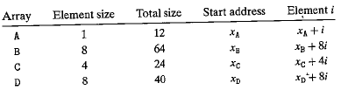
Pointer Arithmetic
consider the following declarations:

Slide 57
Array Allocation
The unary operators & and * allow the generation and dereferencing of pointers. That is, for an expression Expr denoting some object, &Expr is a pointer giving the address of the object. For an expression AExpr denoting an address, *AExpr gives the value at that address. The expressions Expr and *&Expr are therefore equivalent. The array subscripting operation can be applied to both arrays and pointers. The array reference A[i] is identical to the expression *(A+i). It computes the address of the ith array element and then accesses this memory location.

Slide 58
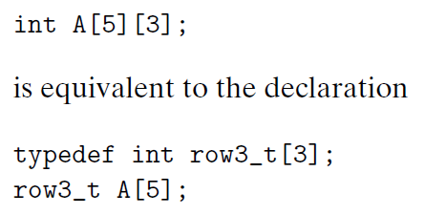
Nested Arrays
The general principles of array allocation and referencing hold even when we create arrays of arrays.

Slide 59
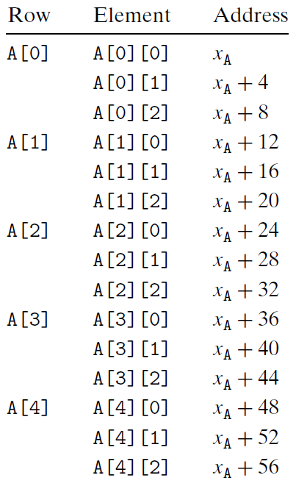
Nested Arrays
consequence of the nested declaration

Slide 60
Structures
C provides special mechanism for creating data types by combining objects of different types: structures. The different components of a structure are referenced by names. The implementation of structures is similar to that of arrays in that all of the components of a structure are stored in a contiguous region of memory and a pointer to a structure is the address of its first byte. The compiler maintains information about each structure type indicating the byte offset of each field.

Slide 61
Structures & Alignment
Unaligned Data
Aligned Data
  Primitive data type requires K bytes
  Address must be multiple of K
struct S1 {
char c;
int i[2];
double v;
} *p;
c
i[0]
i[1]
v
p
p+1
p+5
p+9
p+17
1 byte: char, …
2 bytes: short, …
4 bytes: int, float, …
8 bytes: double, long, char *, …
c
3 bytes
i[0]
i[1]
4 bytes
v
p+0
p+4
p+8
p+16
p+24
Multiple of 4
Multiple of 8
Multiple of 8
Multiple of 8

Slide 62
Alignment Principles
Aligned Data
  Primitive data type requires K bytes
  Address must be multiple of K
  Required on some machines; advised on x86-64
Motivation for Aligning Data
  Memory accessed by (aligned) chunks of 4 or 8 bytes (system dependent)
Compiler
  Inserts gaps in structure to ensure correct alignment of fields

Slide 63
Classwork
Problem 3.45

